Slide 1
Graphics Builder

Slide 2
Oracle Graphics Builder
Oracle Graphics Builder is a Oracle Developer client tool.
It is used for creating charts based on data stored in an Oracle database.
It is designed to allow a user to take data stored in an Oracle database and create a visual representation of that information in the form of a chart .
Graphics Builder provides ten types of charts for different purposes.
Graphics Builder Applications have an extension “ogd”

Slide 3
Topics
Working with charts
Tools available in the Graphics Builder
Creating Graphs
Embedding charts in forms and reports

Slide 4
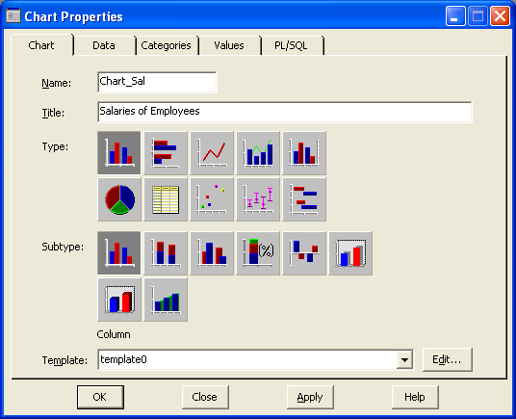
Oracle Chart Types

Slide 5
Oracle Chart Types
Column Chart: Use this chart type to compare sets of data ranges vertically. For example, use a column chart to show the quarterly sales revenue generated by each sales representative.
Pie Chart: Use this chart type to compare the ratios or percentages of parts of a whole. For example, use a pie chart to compare annual revenue by department or quarter.
Bar Chart: Use this chart type to compare sets of data ranges horizontally. For example, use a bar chart to compare monthly revenues.

Slide 6
Oracle Chart Types
Table Chart: Use this chart type to show data in a table format. For example, use a table chart to show an employee organization chart.
Line Chart: Use this chart type to show vertical changes for a specific set of data. For example, use a line chart to gauge daily or hourly changes in a stock's value.
Scatter Chart: Use this chart type to show data along two value axes. Scatter charts are well suited for showing standard deviations.
Mixed Chart: Combines multiple plot types such as column and line. For example, use a mixed chart to show daily sales revenue, with a line plot type to provide a summary view of the data.

Slide 7
Oracle Chart Types
High-low Chart: Use this chart type to show values fields that correspond to high, low, and close (i.e. stock prices).
Double-Y Chart: This chart type provides two independent Y-axes on which to plot data. Each Y-axis can show a different range of values.
Gantt Chart: Use this chart type to show sets of project data over a given amount of time. Gantt charts are generally used to show project milestone timelines.

Slide 8
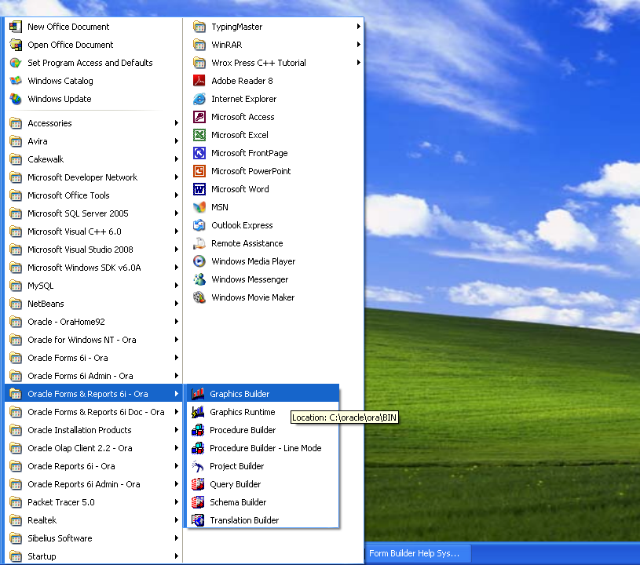

Slide 9
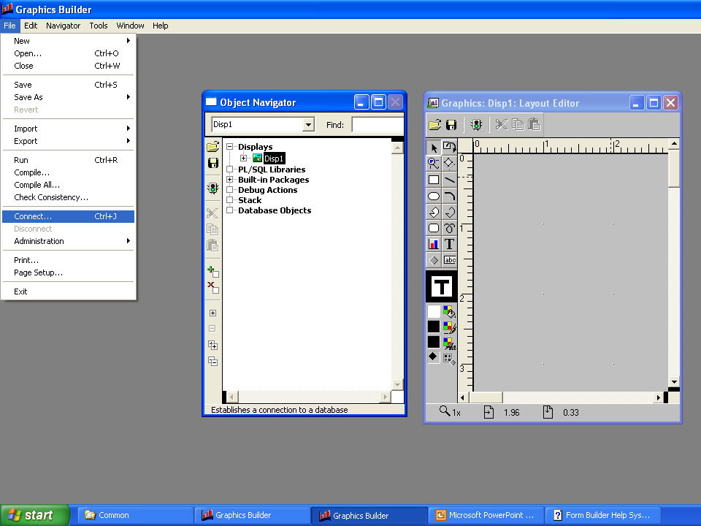

Slide 10
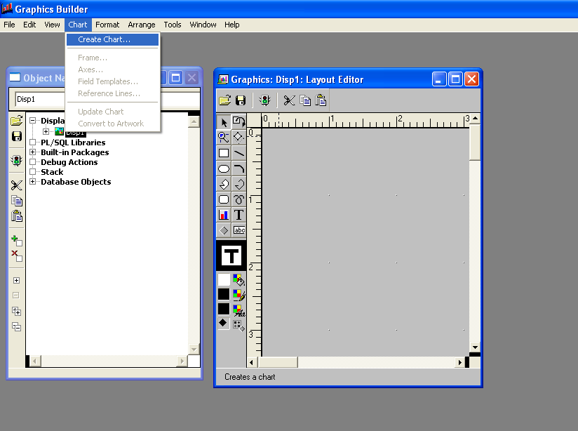

Slide 11
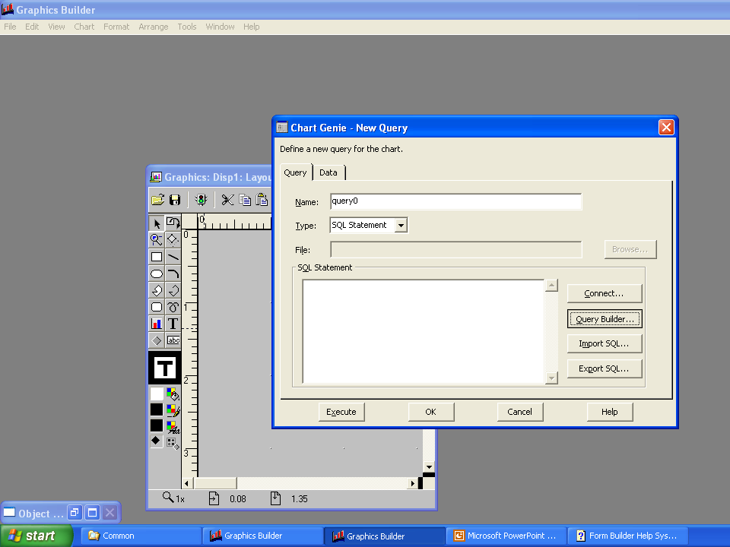

Slide 12
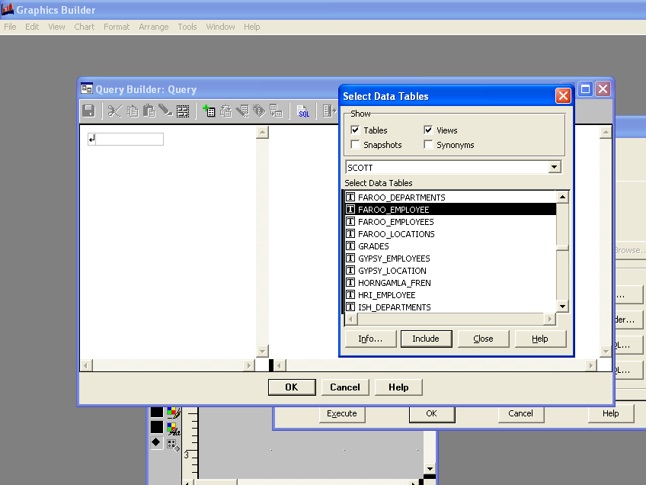

Slide 13
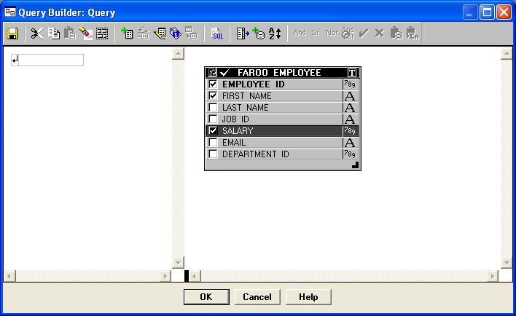

Slide 14
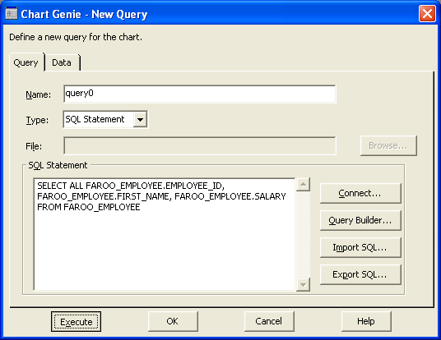
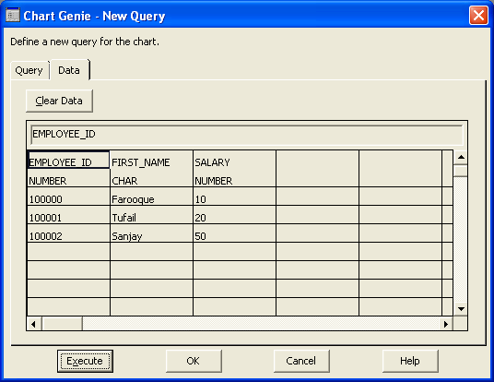

Slide 16
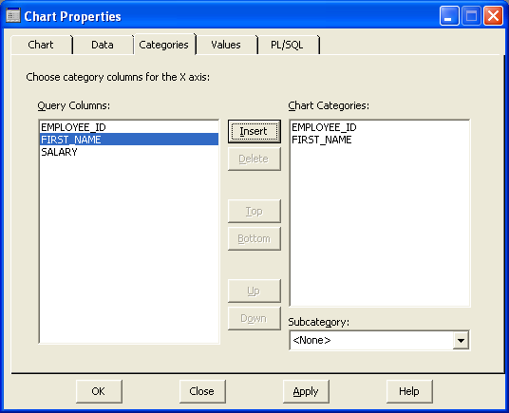
Categories are usually plotted along a discrete or date axis, which may then also be called a "category axis."

Slide 17
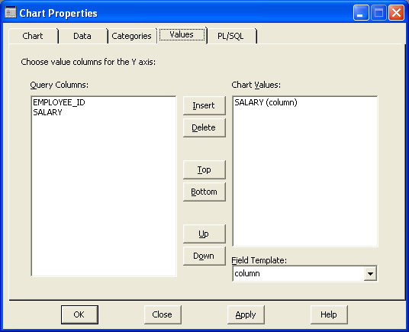
Values are usually plotted along a continuous axis, which may then also be called a "value axis."

Slide 18
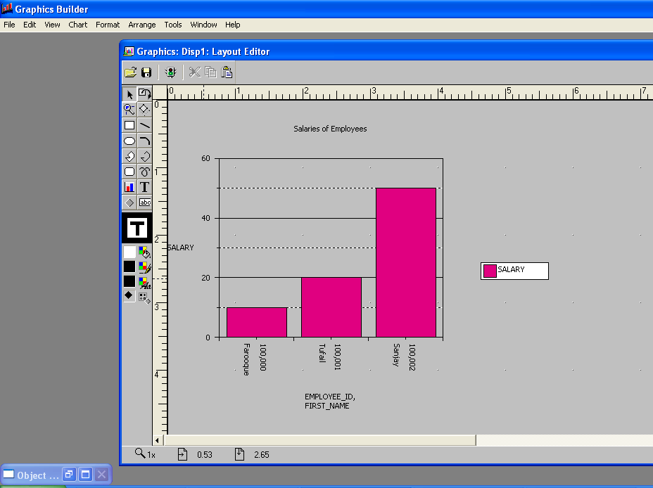
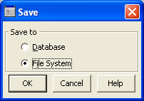

Slide 19
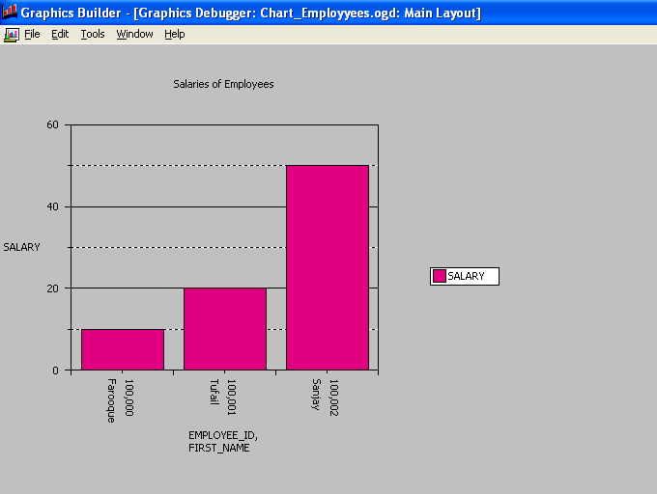
Press Ctrl + R to run the Graphics Builder Application

Slide 20
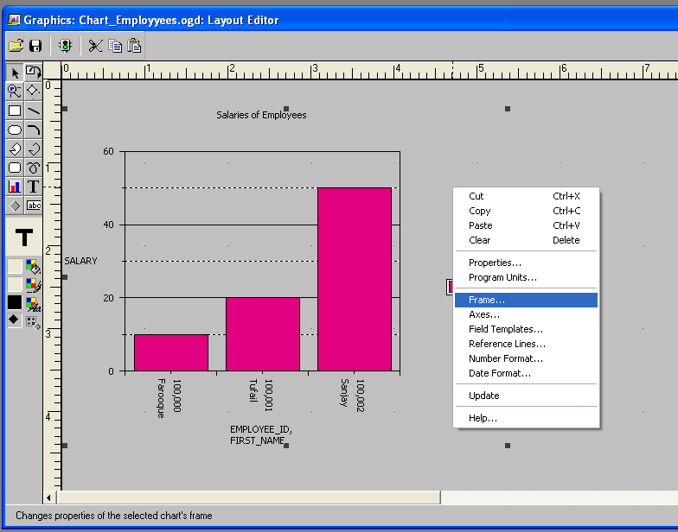
To make changes to the Frames: Right Click → Frames

Slide 21
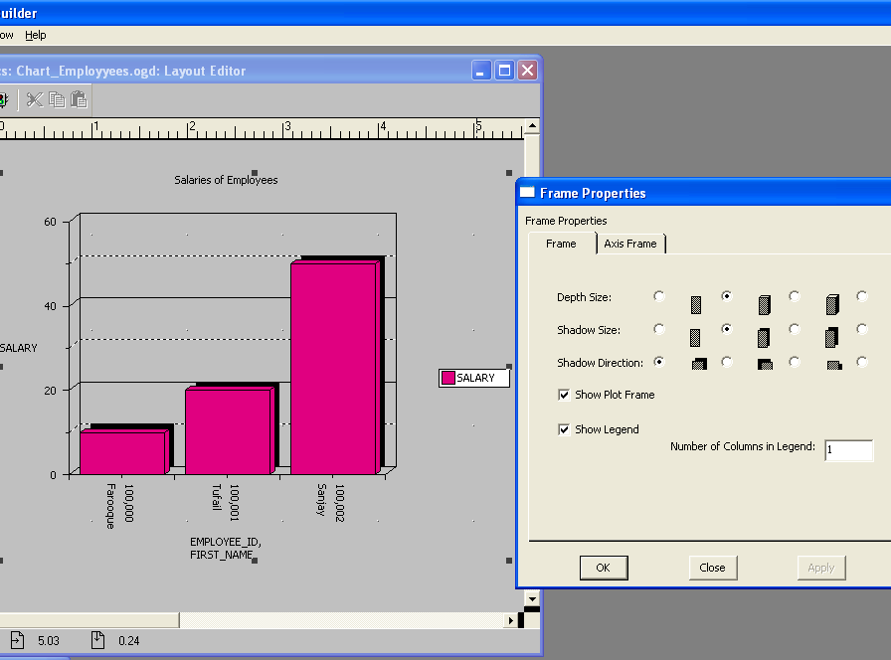
Select the type of frames you want for your chart

Slide 22
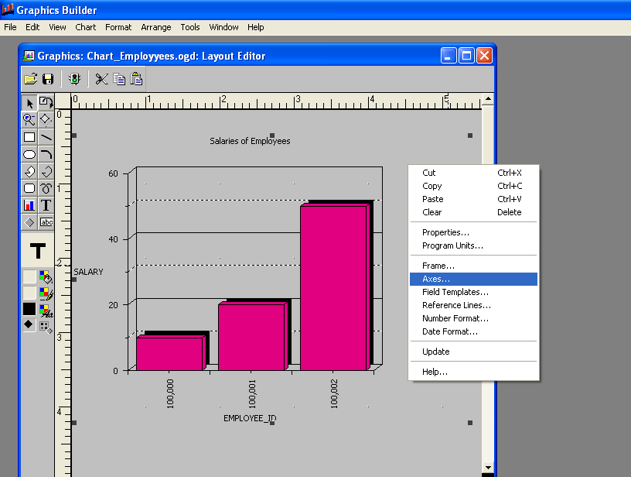
To make changes to how values are plotted in axes: Right Click → Axes

Slide 23
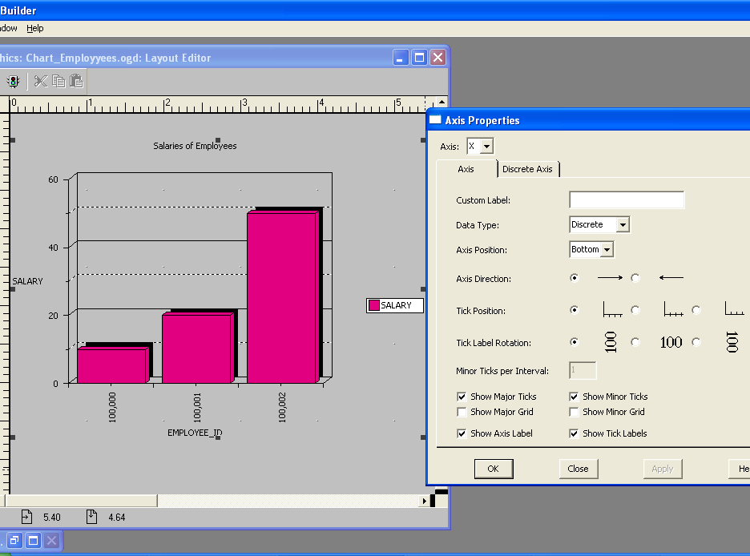
Select desired setting for plotted values along x axis

Slide 24
Designing the chart
After the chart is generated, we can change the color of the figure selected, same process as in Forms Builder
We can format the font of the of the text in the chart displayed. Go to Format->Font
We can increase the size of the chart or position it accordingly

Slide 25
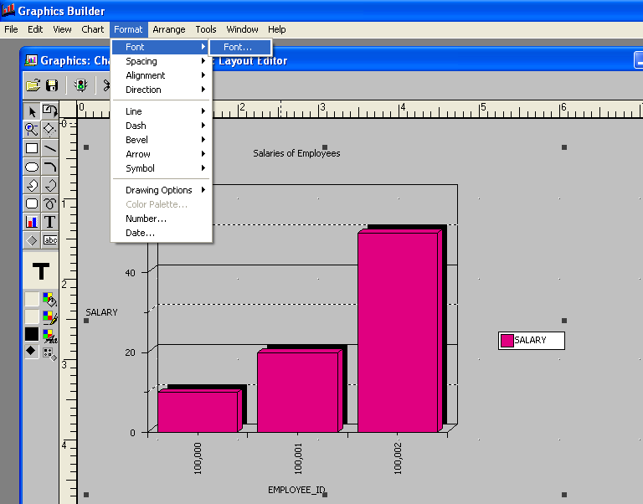
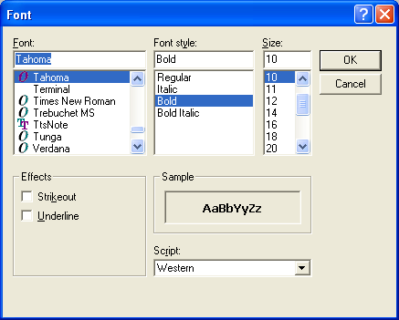
Changing the Font.

Slide 26
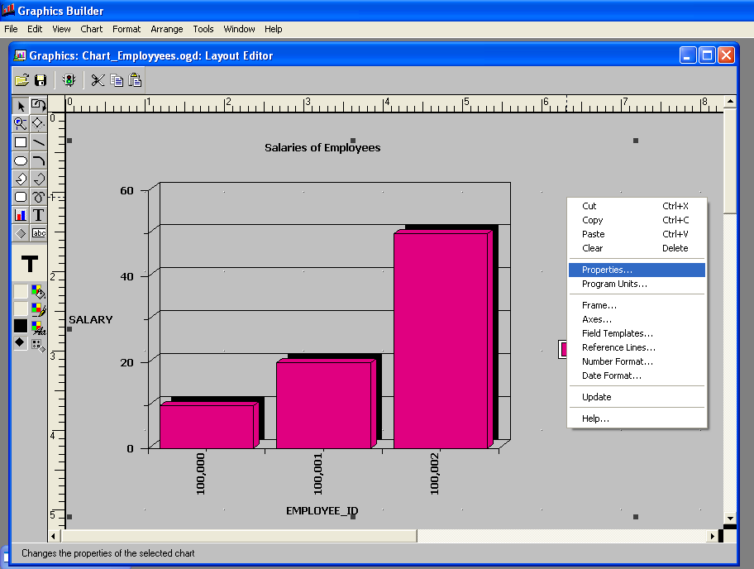
If you want to make any changes to an already created chart like chart type, etc. after chart creation. Right-click → Properties to get the following slide’s dialog box.

Slide 27
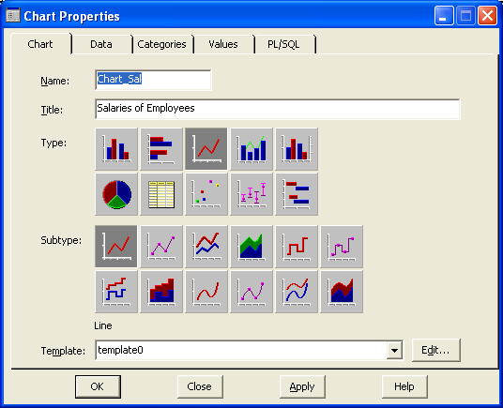

Slide 28
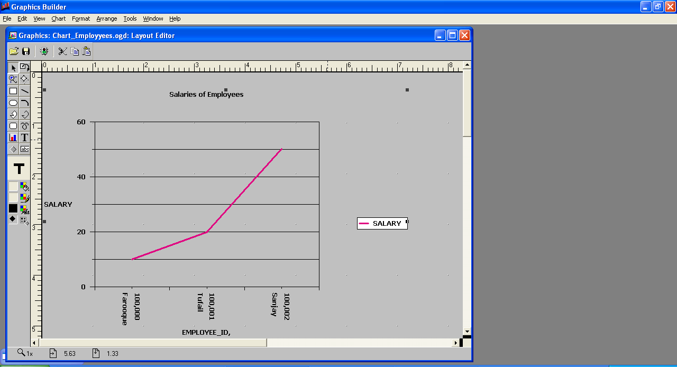
Here, the same Column Chart above was changed to Line Chart

